Slide 1
Topic: Screen Design
NAME: Arsam Fayyaz Roll No: 19SW46
* See slide notes for page directions
Notes:
When listing all project collaborators, either use commas or bullets

Slide 2
What is Screen Design?
It is a sub-area of user interface design
The focus is on maximizing usability and user experience.
Technicalities does not matter.
A central approach in screen design is orientation to the target group’s needs and abilities.
Making interaction easier for users.
Notes:
Insert a map of your colony (draw it, ink it, or create it in PPT- be creative!)
Insert -> Pictures for photos
Draw for digital inking
Insert -> Shapes if you want to create it in PPT
All mountains, towns/villages, bodies of water/waterways, landmarks, etc. should be clearly labeled

Slide 3
Applications of screen design
Screen design is used in mobile and desktop versions of websites, apps.
This includes computers, portable media players, gaming devices, smartphones, and household, office, or industrial controls.

Slide 4
What makes good screen design?
Focuses on users
Screen design doesn’t reinvent the wheel
Less is more
Based on user preferences
Elements are arranged in a way that is appealing to the user.
Good screen design considers past elements and their appearances.
Adapt to new applications easily.
Companies developing a library of standard screen templates.
Much details might overload a screen.
Requires minimum space between sections.
Dividing the content into sections.
Use colors to highlight the content and standard fonts.
Notes:
Think about the questions listed above and answer them.
Can you think of anything else in regards to economy and trade that you would like to add?

Slide 5
Comparison:
Good Screen Design:
Bad Screen Design:
Screens are less crowded
Would be less time consuming, 25 percent less time
Screen would be 20 percent more productive
25 percent fewer errors
Improve decision making time
The organization customers benefit.
People will have greater difficulty in doing their job
More prone to mistakes
Chase people away from the system
Lead to aggravation, frustration and stress
Notes:
Use the SmartArt to determine the flow of government/leadership:
Who leads the colony (executive)? What is that person/are those people’s duties?
Who makes the rules (legislature)?
Who ensures the rules are followed (judicial)?
Are there any other branches of government? If so, who are they and what is their job?
To add more shapes, click on the left shape first, then on SmartArt Tools -> Design -> Add Shape After
Do the same for the shape to the right
Feel free to rename the branches!

Slide 6
Basic principles:
Ask
Think
Design
Notes:
What are the rules and laws of your colony? Think about what helps the colonists stay safe and maintain a healthy, happy colony.
In each shape…
Name the rule/law
Describe why it’s important for the colony/colonists
Explain the consequences for not following this rule/law
To add more shapes, click on the last shape, then on SmartArt Tools -> Design -> Add Shape After

Slide 7
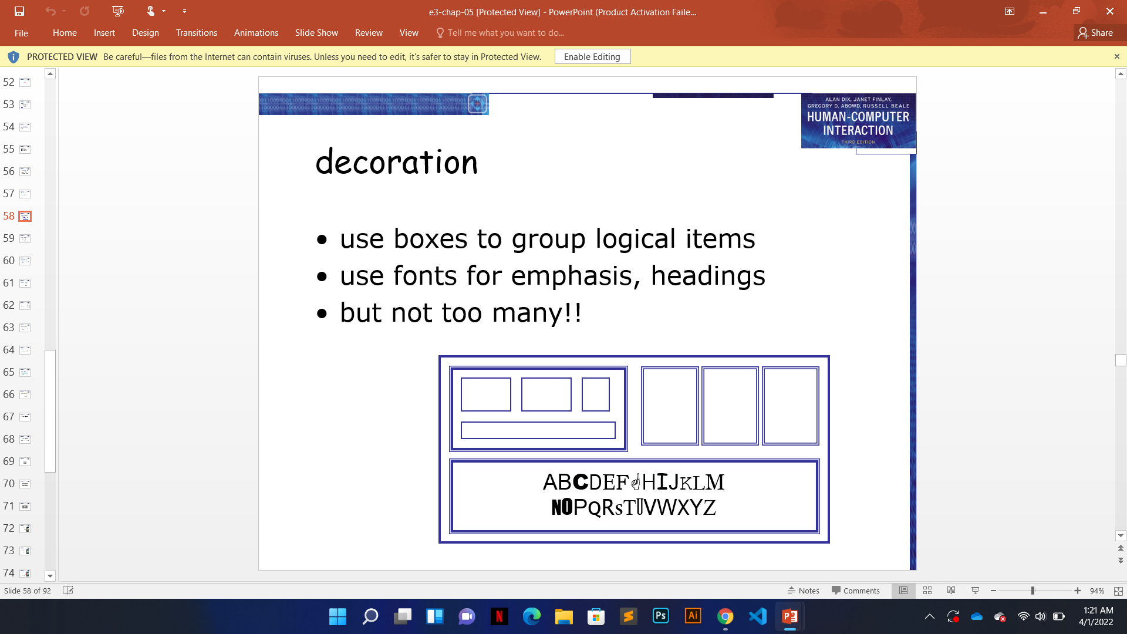
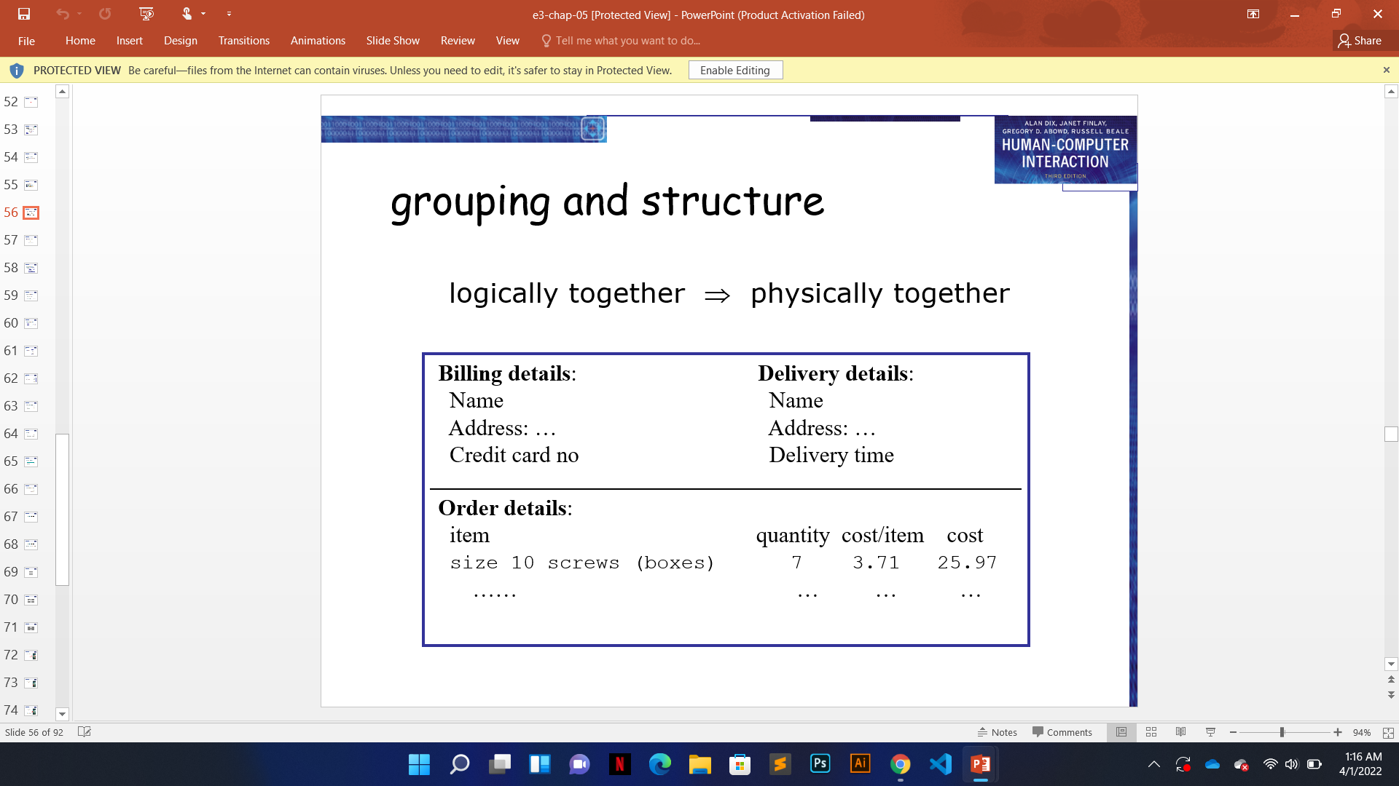
Available tools:
Grouping and Structure:
Order of groups and items:
Decorations:
THINK?
Should match screen order.
Notes:
Think about the questions/situations listed above and answer them.
Can you think of anything else in regards to transportation that you would like to add?

Slide 8
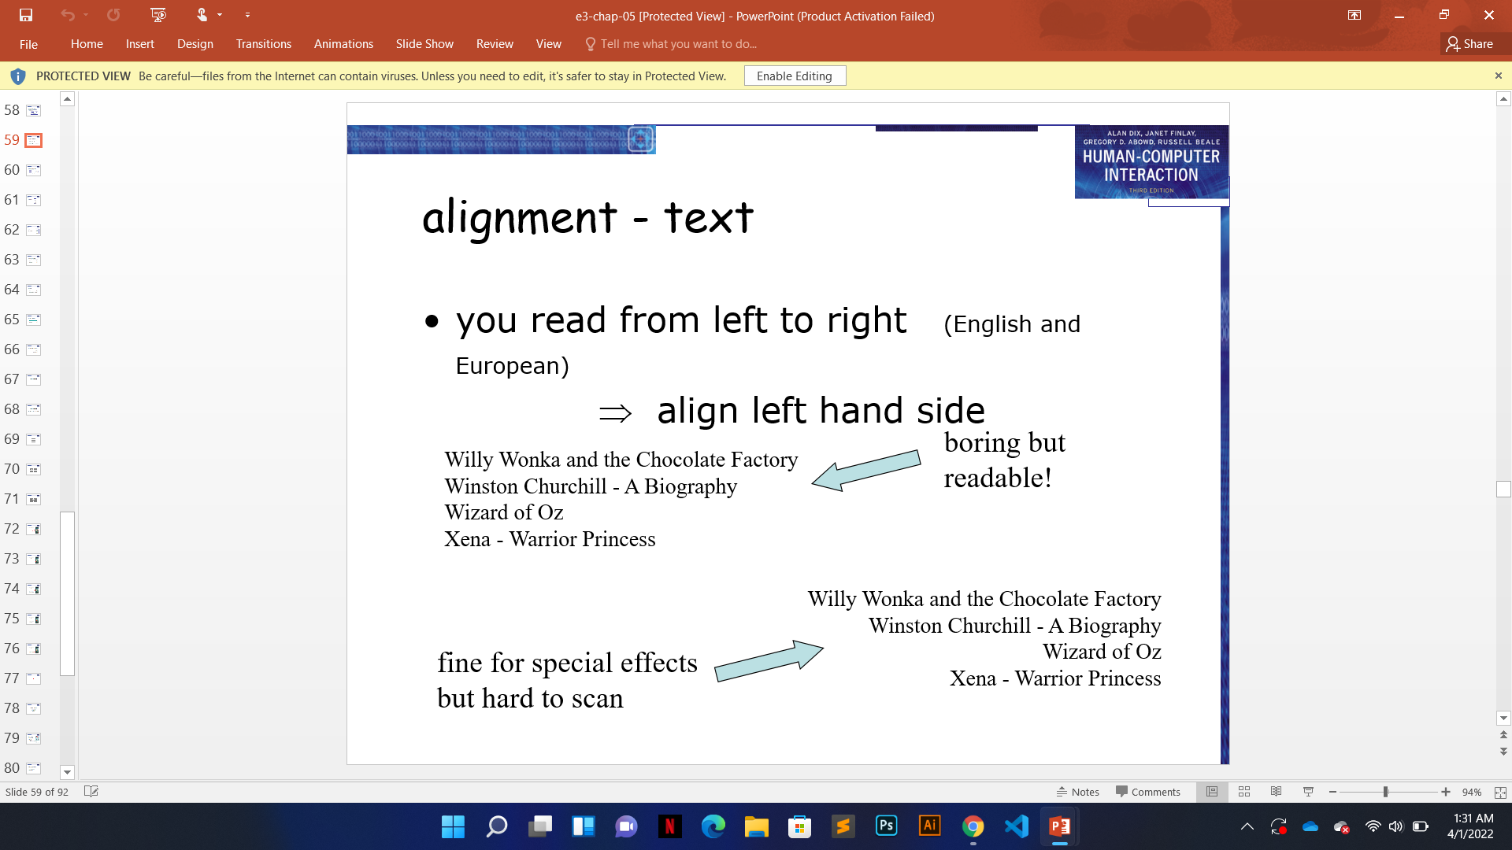
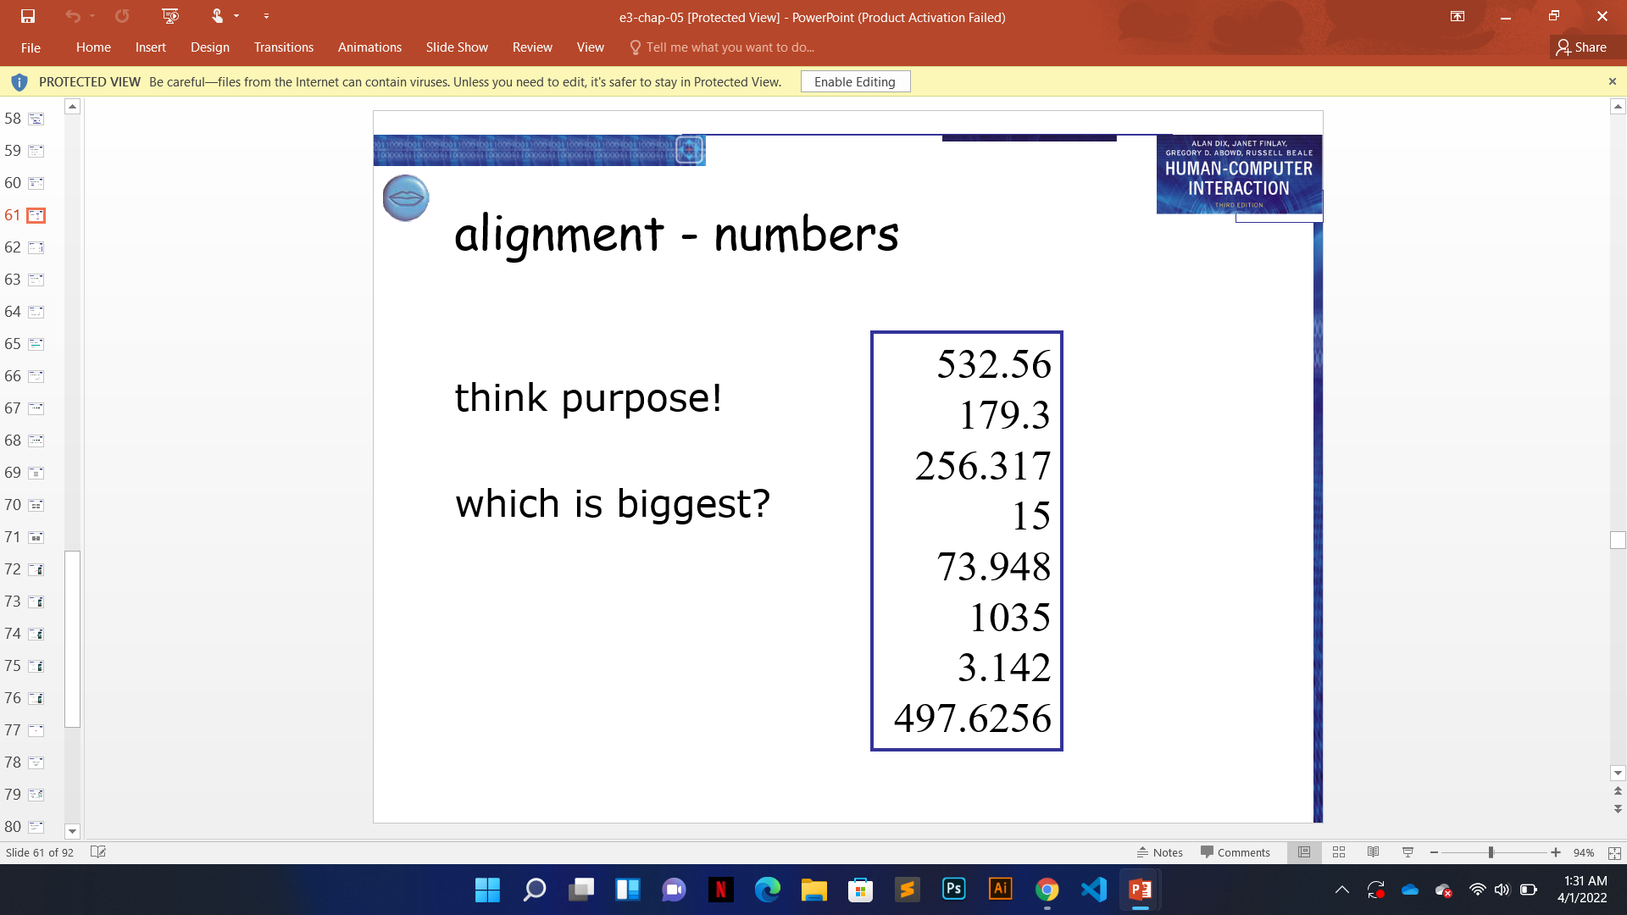
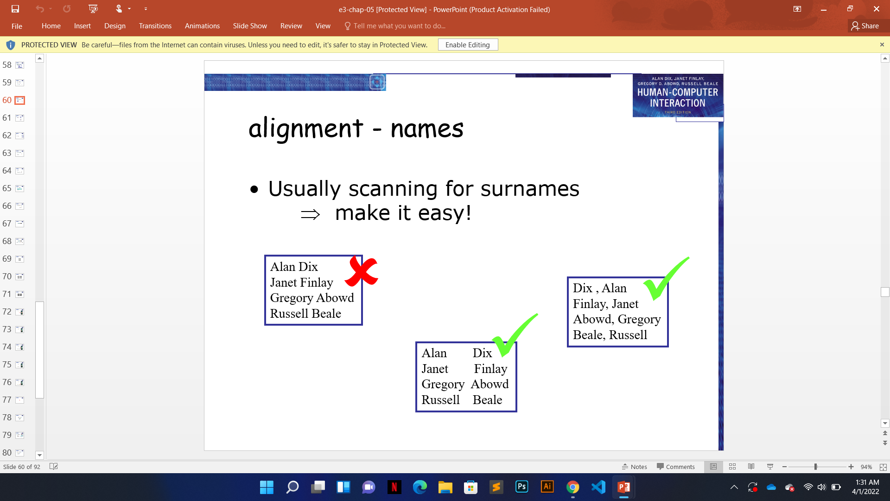
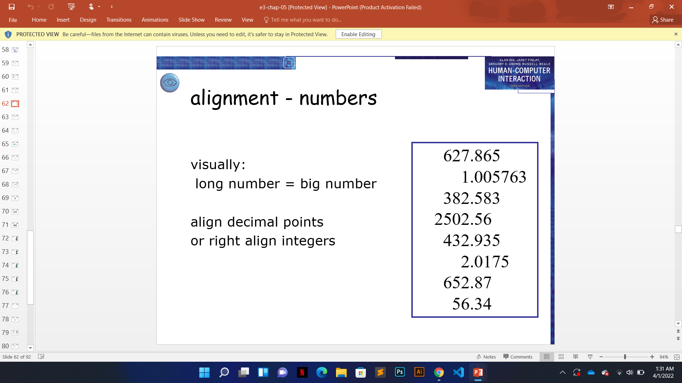
Alignment:
TEXT
NAMES
NUMBERS
Notes:
Think about the questions/situations listed above and answer them.
Can you think of anything else in regards to transportation that you would like to add?

Slide 9
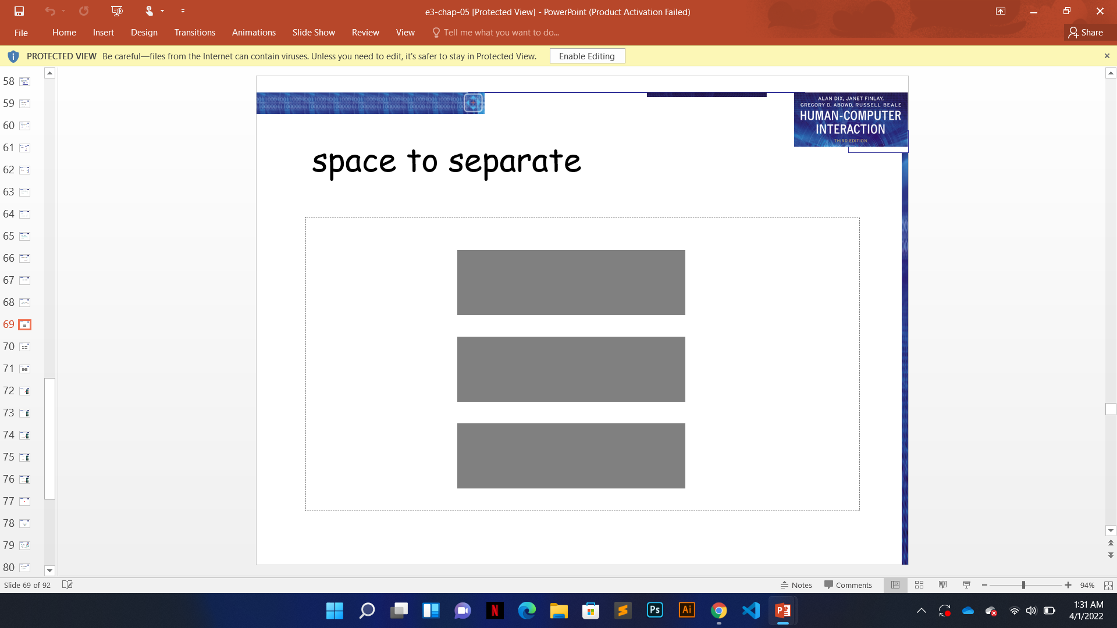
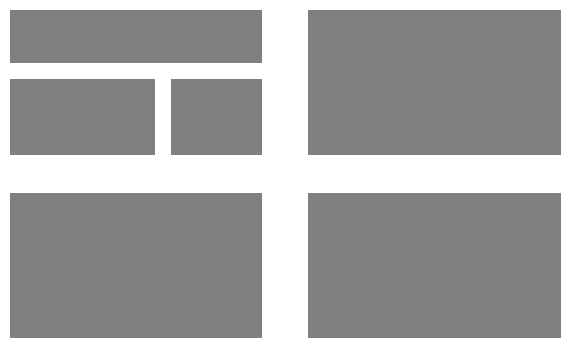
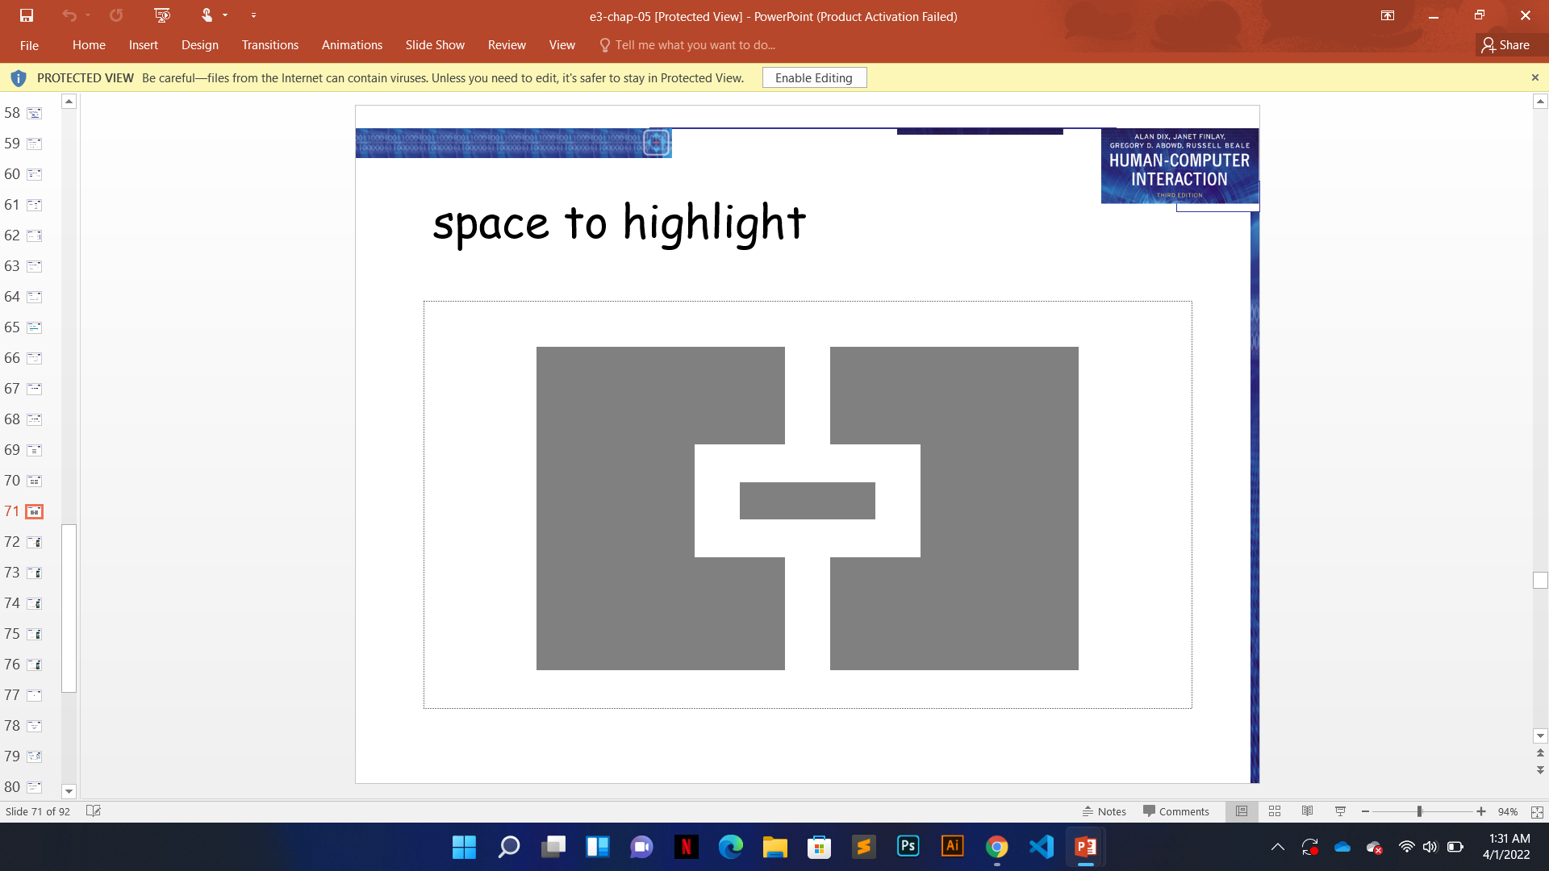
Use of Whitespaces
Notes:
What is the name of your colony song?
Write lyrics to the song and, if you are feeling creative, use a computer program or instruments to create the music that goes along with it!
To insert an audio file, click on Recording -> Audio -> Audio on My PC and choose your file

Slide 10
THANKS ☺

